Slide 1

Ph.D. Research Overview
Yihe Tang
31.01.2024
Notes:
Hello everyone, I am delighted to share my research over the past two years during my PhD.

Slide 2
Contents
Background
Method
Research 1
Research 2
Research 3
Notes:
Mainly includes the following 5 contents.

Slide 3
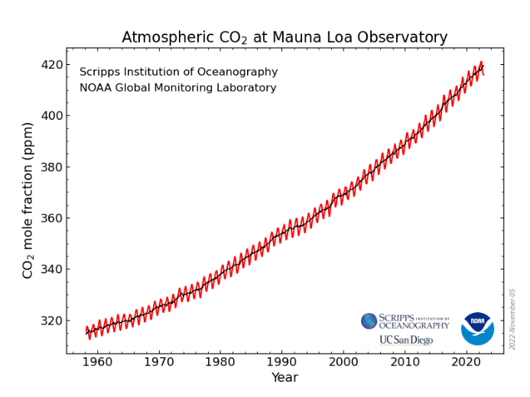
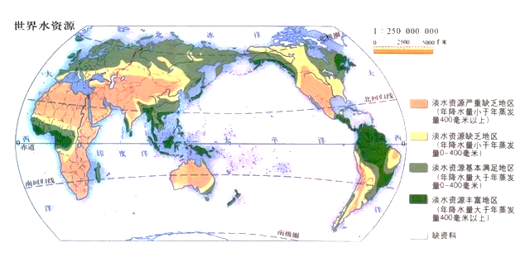
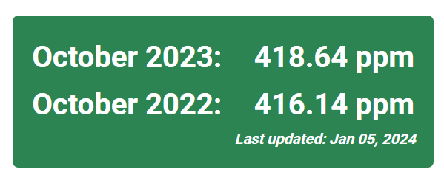
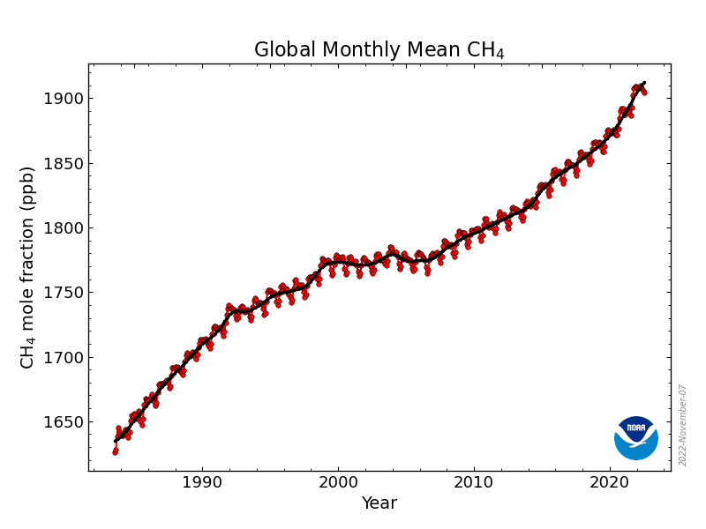

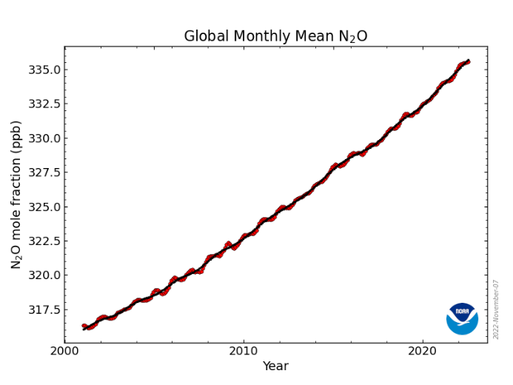



Background
Climate warming
Freshwater resource shortage
CO₂
CH₄
China supports 21% of world’s population with only 6% of its water resources
Agricultural plays a crucial role
14%
70%
N₂O
The proportion of agricultural greenhouse gas emissions to the total.
（IPCC）
The proportion of agricultural water use to the total water consumption.
（ FAOSTAT ）
（NOAA）
Notes:
First of all, there is the background: Global warming and freshwater scarcity stand out as two critical global challenges.
Presently, concentrations of major greenhouse gases—CO₂ (carbon dioxide), CH₄ (Methane), and N₂O (nitrous oxide)—are steadily increasing, reaching historical peaks, and intensifying the global climate change. Meanwhile, because of the uneven spatial and temporal distribution of water resources, the problem of freshwater scarcity is becoming increasingly pronounced.
Agricultural production occupies an important role in both greenhouse gas emissions and water resource consumption.
Greenhouse gas emissions from agriculture contribute to 14% of the total, while agricultural water use surpasses 70%.
Given that cultivation is an important part of agricultural production, so investigating the water and carbon effects of cultivation has become a key point of current research.

Slide 4
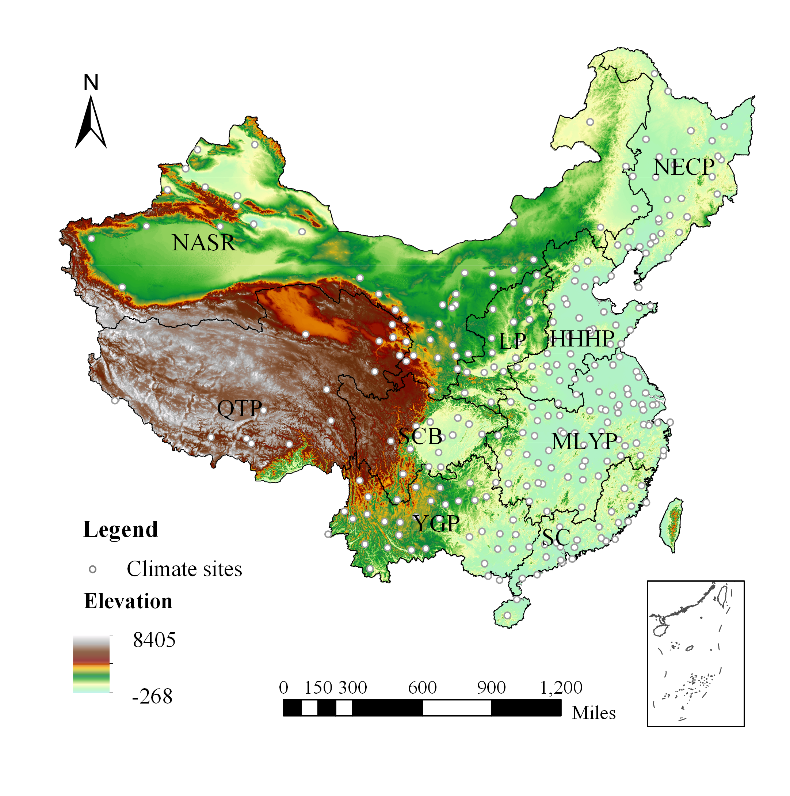
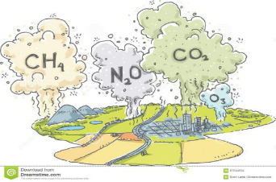

Background
China
Agricultural System
What can we do?
Method
The DNDC model
The DNDC model
+
City level farmland data
Water-Carbon flux
Greenhouse Gases
Water demand
Assessing the spatial and temporal evolution of water-carbon fluxes of major grain in China and clarifying their response mechanisms to planting structure.
Differentiated cropping pattern and climate
Response Mechanism
Regional differences
Problems
Notes:
My current research centers on analyzing cropping patterns and climate types across various regions in China. using the DNDC model, I simulated greenhouse gas emissions and water demand throughout the entire crop growth cycle.
The major objective is to assess the spatial and temporal evolution of water-carbon fluxes in major grain in China, and clarify their response mechanisms to various environmental drivers.

Slide 5
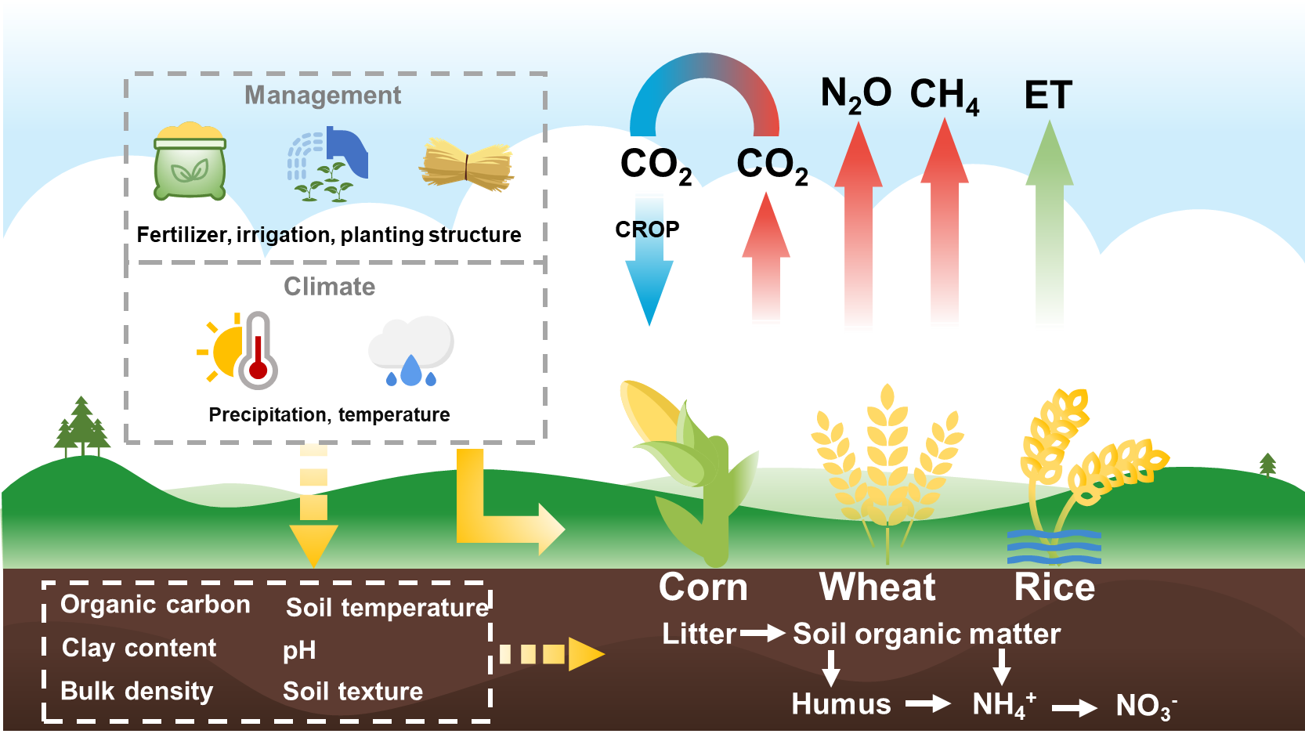
Background - General Idea
DNDC
Notes:
I have drawn a diagram to represent the general idea of my research.
Climate and field management affect cropping water-carbon processes through two main pathways.
The first one is directly affecting the crops. These elements include growing temperature, crop growth cycle and others.
The second pathway is influencing soil physicochemical properties，such as soil organic carbon, temperature and others. We handed over the work of soil and crops to the DNDC model. Based on this, it is a worthwhile to analyze the driving mechanism(ˈmekənɪzəm) of these factors on agricultural water carbon flux.

Slide 6
Method - Database
Sites data
Gride data
Statistical data
Database of major crops at the city-level in China
Interpolation
Interpolation
Data sources:
China's city-level agricultural statistics, meteorological station data and HWSD soil dataset.
Establishment of a Chinese city-scale major crop database using Matlab and ArcGIS platform.
Interpolation of missing data.
Climate
Soil
Crop
city
Max temperature
Mini temperature
Percipitation
- Planting date
- Harvesting date
- Crop area
- Crop types
- Varietal parameters
- soil capacity
- Ph
- Clay
- SOC
site
Management
Matching site data to boroughs based on latitude and longitude
- Fertilizer
- Irrigation
- Residue management
Notes:
Before proceeding with the follow-up works, we need to establish a database to store the data. This database will include four types: climate, Soil, Crop, and Management. When running the model, it is essential to match the data. It means that a single code is used for the various data of a grid.
The original data I obtained includes point data for climate and Soil, while Crop and Management data are at the city level, with one value per city. We need to match the data based on latitude and longitude. and we also neeed interpolate missing data during the process.

Slide 7
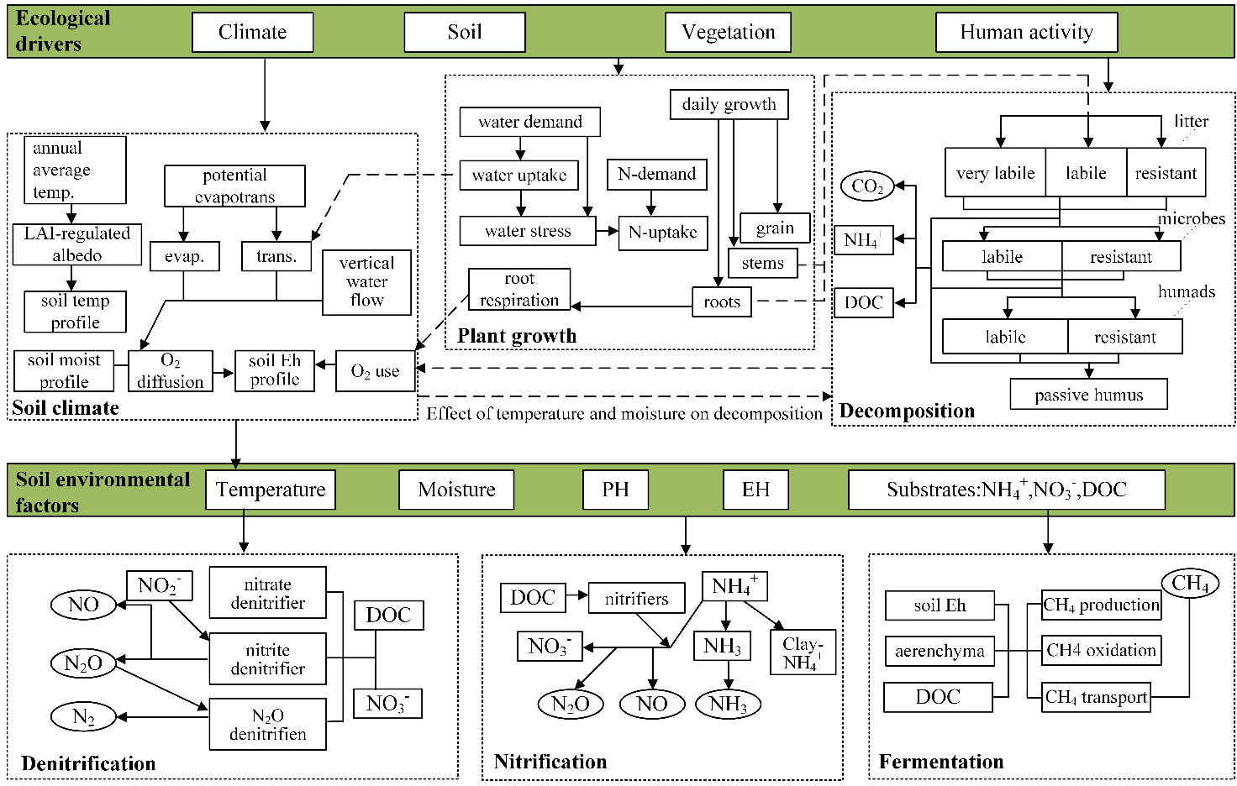
Method - DNDC Model
DNDC model——Calculation of GHG emission fluxes by crop
O
Advantages of DNDC：
The process mechanism model to simulate the transfer of carbon and nitrogen from soil to the atmosphere using denitrification and organic matter decomposition processes is highly reliable.
The model has been validated in several regions around the world.
Distinctions between crop types and varieties can be made.
Simulations can be performed separately for sites and regions.
DNDC model structure diagram（Li et.al 2003）
Global warming potential (GWP)——Calculation of the combined greenhouse gas effect
$$GWP={CO}_{2}+N_{2}O×273+{CH}_{4}×27$$
Notes:
We use the DNDC model as the major method，which is divided into two key parts, Ecological Drivers and Soil Environment Factors.
The denitrification/diːˌnaɪtrɪfɪˈkeɪʃn/ and nitrification processes are the key of this model. This enables us to acquire diverse greenhouse gas (GHG) flux data.
While there are numerous models could simulate greenhouse gas, Why we choose the DNDC model.
Firstly, the DNDC model is a process mechanism model, ensuring a high level of reliability. Its widespread use in various studies, particularly in multiple regions across China, adds to the credibility of our own research.
Secondly, the DNDC model account for different crop types and varieties, it’s useful for study. Finally, the model allows for simulations at both specific sites and broader regional scales. Batch simulation is possible, which is the key to our large-scale research.

Slide 8
Method - Model Validation and Parameterization
Workflow：
Parameterization
2.
2. Obtain a set of crop parameters that match each city in China
Monte Carlo method
Modified model parameters
region
Yield
sites
Measured data from field
1.
DNDC
CO₂,CH₄,N₂O
flux
1. Verify the applicability of the DNDC model in China
Results
(Yield, GHG, Water)
Soil temperature
Biomass
of crop parts
Compare with measured value
Model validation
Notes:
As is common practice, before model utilization, a crucial step is ensuring its suitability适用性 for the specific research region. We have established a workflow to illustrate the process of validation and parameterization
(1)First is Validation, we need to prove that the model works in China, here we use some data from publishment. Such as GHG flux; Soil temperature and Biomass of crop parts.
(2) The second is Parameterization, Using yield as a reference object.
Finaly, we will obtain a set of crop parameters that match each city in China.

Slide 9
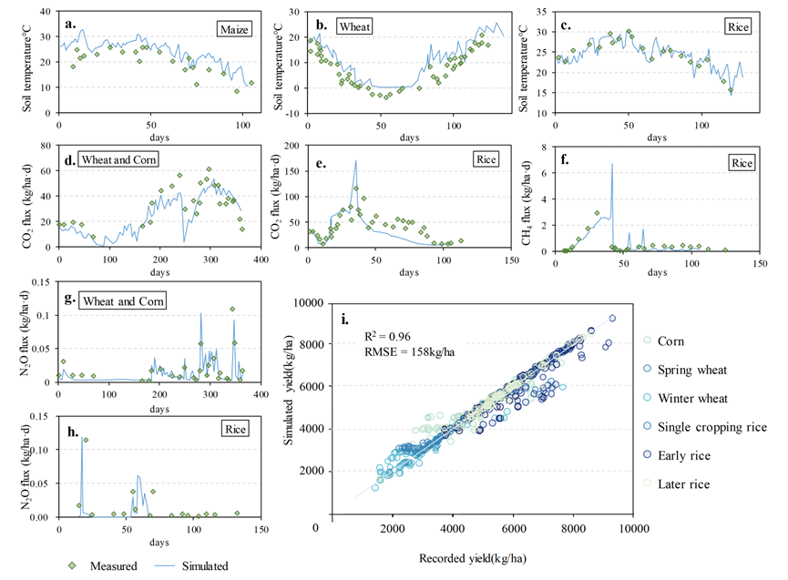
Method - Model Validation and Parameterization
Root mean square error （RMSE）
R squared（R²）
Fig. 1 Model Validation and Parameterization
Notes:
Fig1 is the result of the previous step. In the figure from a to f is the result in sites scale. We compared the daily data, such as Soil temperature, CO2, menthe and N2O.
The last figure shows a comparison between the measured yield and the simulated yield. We have collected 1191(one thousand one hundred ninety-one) samples across three different crops. And we use RMSE and R squared to evaluate the goodness of fit.
These metrics provide a evaluation of the model's performance, ensuring that the simulation closely with the observed data.

Slide 10
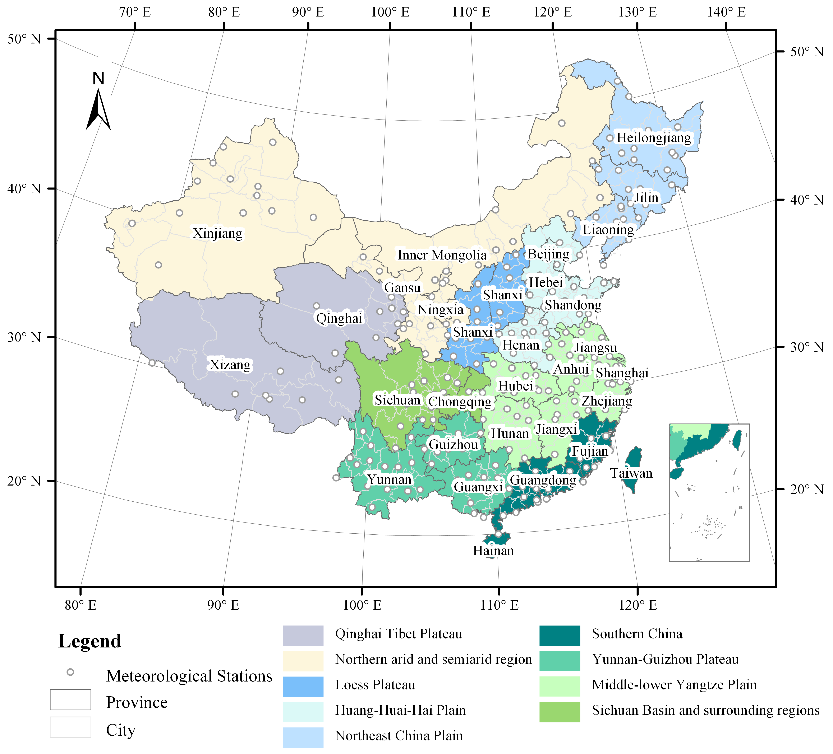
Method – Research Scale
According to administrative regions, China is divided into 31 provinces.
The 34 provinces are subdivided into 337 cities.
The smallest simulated unit in this study is the city.
According to the characteristics of agricultural production, China is divided into 9 agricultural regions with provinces as borders.
Country＞Agricultural region ＞ Province ＞ city
1
9
31
337
Fig. 2 Map of the study area
Notes:
Considering the huge size and various features of China, We zoned the entire country to better understand its different regions. We have zoned China into 9 agricultural regions, further divided into 31 provinces and 337 cities. Due to the lack of data, certain cities—such as those in the Taiwan island—are omitted from our analysis.

Slide 11
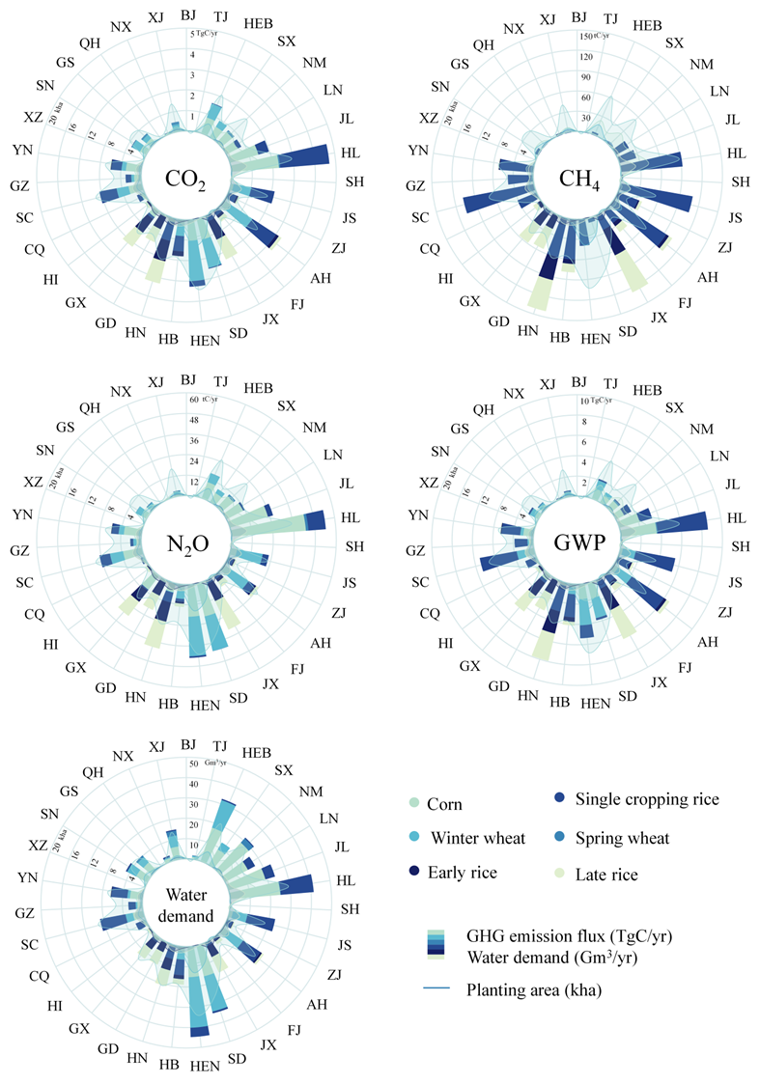
Research 1
Paper 1
Assessing the impact of climate and crop diversity on regional greenhouse gas emissions and water demand of cropland
Time: 2015
Crop: Corn, Wheat, Rice
Minimum unit: city
Fig. 2 Greenhouse gas emissions and water demand by province in China, 2015
Notes:
Based on the above approach, this is the topic of my first research.[指标题]
In this section, our focus around evaluating the greenhouse gas (GHG) emissions and crop water demand associated with major grain production in China.
Figure 2 shows the results at the province-level, which come from 3 different grain, and we have divided it to six species due to the different growing seasons. Such as wheat was divided into Spring wheat and winter wheat.
The study‘s time is set at 2015(two thousand and fifteen), because in 2015 the planting area with grain in China reached a relative peak. Additionally, We added the grain area of each province to the figure for simple comparison

Slide 12
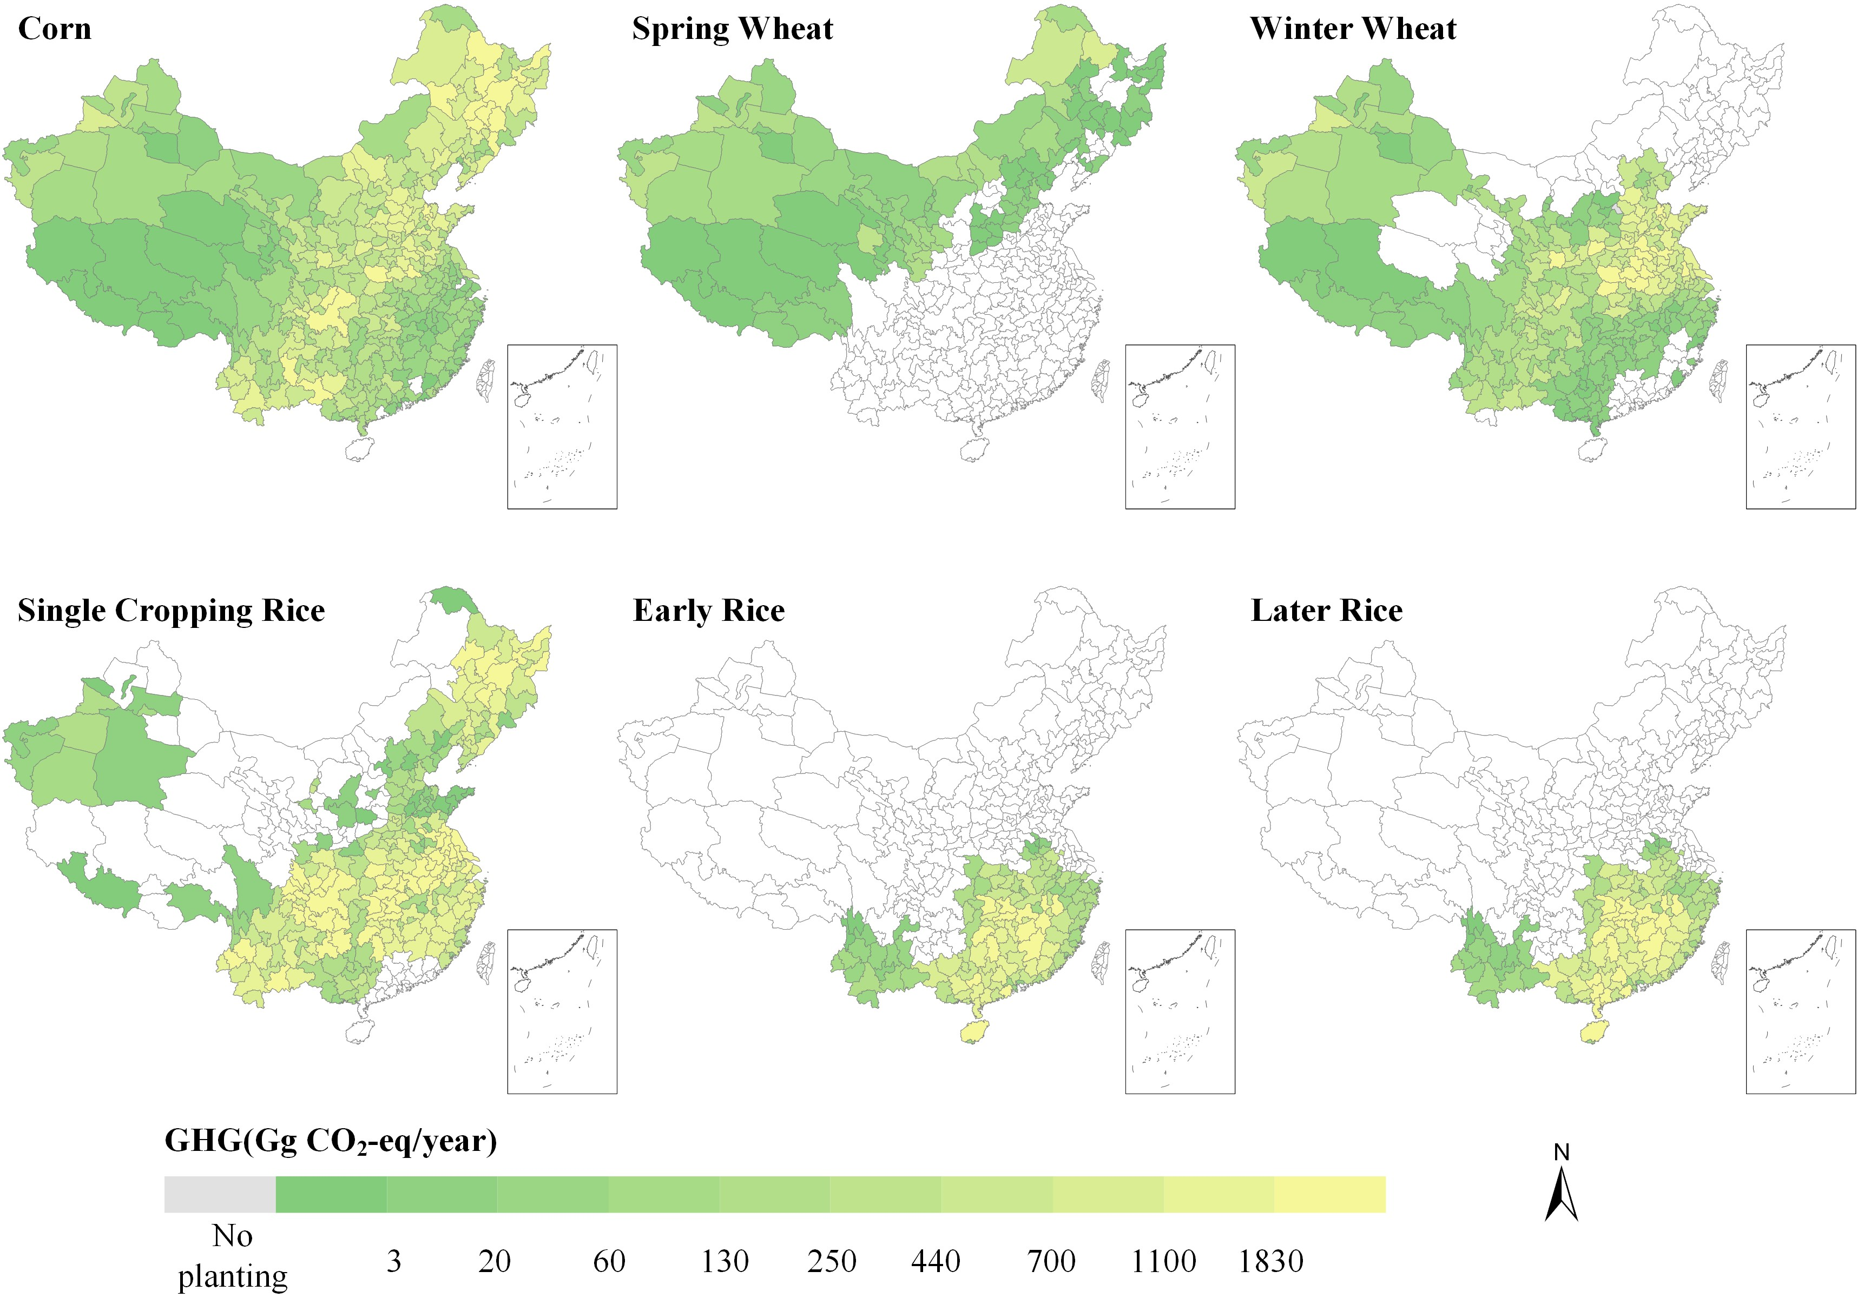
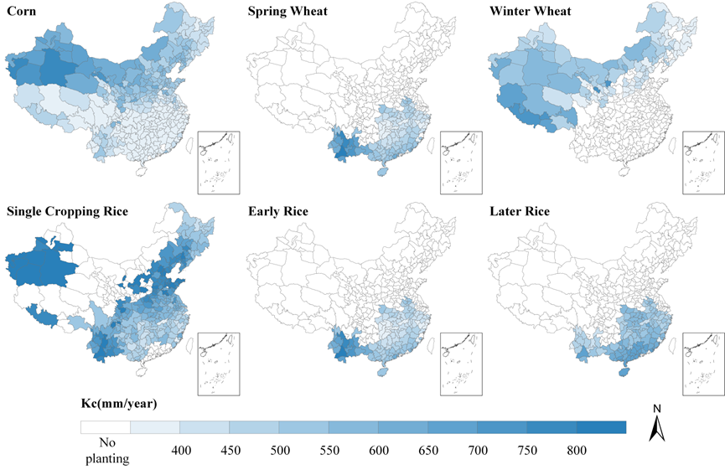
Research 1
Fig. 3 Greenhouse gas emissions
Fig. 4 Water demand
The geospatial distribution of GHG emissions and water demand displayed opposite patterns, with climate conditions and crop types as the main reasons.
Notes:
Figures 3 and 4 provide a detail of GHG emissions and water demand at the city level. Blank areas on the map indicate regions where no planting.
This figure allows us to learn distinct features in various regions. Notably, emission hotspots vary for different crops. Such as, The northeast region produces the most emission from growing corn.
Moreover, by comparing spatial differences, we can see opposite patterns in GHG emissions and water demand. It means Low water demand in regions with high greenhouse gas emissions.
Climate conditions and crop types is the major reason to these difference.

Slide 13
Research 1
Significance and policy Recommendations
Thorough Exploration of Water-Carbon Effects:
Our study provides a comprehensive exploration of the water-carbon effects in farmland, revealing significant variations among different crops and regions.
Importance in Water Demand and Agricultural Planning:
The findings underscore the critical importance of fully considering differences in water-carbon effects among various crops in water demand and agricultural planning. Adjusting the planting structure accordingly becomes imperative to achieve both water conservation and emission reduction in agriculture.
Potential for Strategic Food Production Shift:
This study proposes the potential for a strategic shift in food production, advocating for a move from high water consumption and emission areas to regions with lower water consumption and emissions. Such a shift could facilitate the production of more food with less water, thereby reducing emissions. This strategic realignment has the potential to alleviate water pressure and foster sustainable agricultural development.
Notes:
Based on this research we can gain the following points:
We can see: In water demand and agricultural planning, it is important to fully consider the differences in water-carbon effects among various crops.
This study suggests a potential shift in grain production from high water consumption and emission regions to lower water consumption and emissions regions , or from high water consumption and emission crops to lower water consumption and emissions crops.
Helping to make more food using less water and fewer emissions. This smart decision could ease the strain on water and promote sustainable agricultural development.

Slide 14
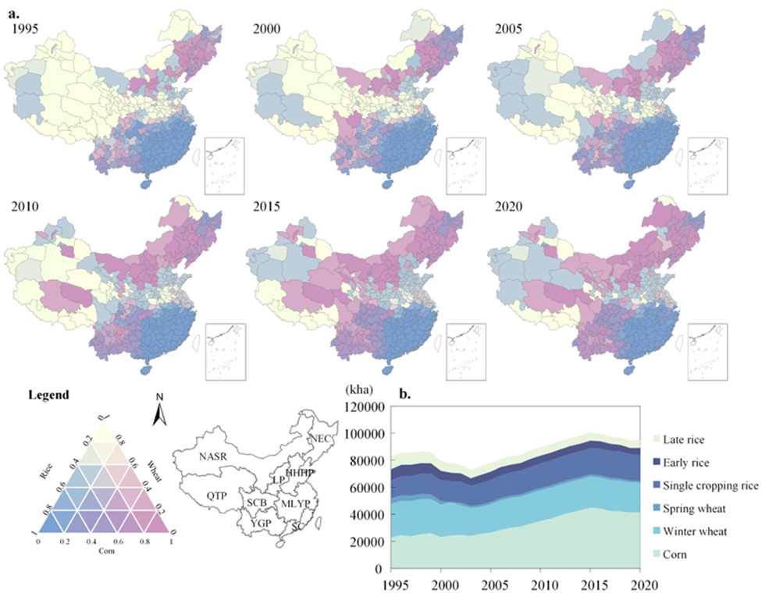
Research 2
Paper 2
Cropping pattern switching induces disturbances in spatiotemporal greenhouse gas emissions and water demand
The cultivation scale of China‘s grain has exhibited a fluctuating upward trend, with four distinct stages of change.
As shown in Fig. 1a, since 1995, in northern China, cities where wheat was the dominant crop have gradually been replaced by corn and rice.
Fig. 5 Cropping pattern of major grain
Notes:
Based on the insights from Research 1, We discovered the positive influence of suitable cropping patterns on water conservation康色威神 and emission reduction in agriculture.
My second research delves into understanding the impacts of changes in cropping patterns on agricultural water and carbon. As shown in Figure 1a, Cropping patterns in China have changed. More and more areas planted with wheat became planted with corn. Total acreage is increasing.
This transition raised important questions about the Dynamic changes of water carbon in response to changing cropping patterns, forming the key of our ongoing investigation.

Slide 15
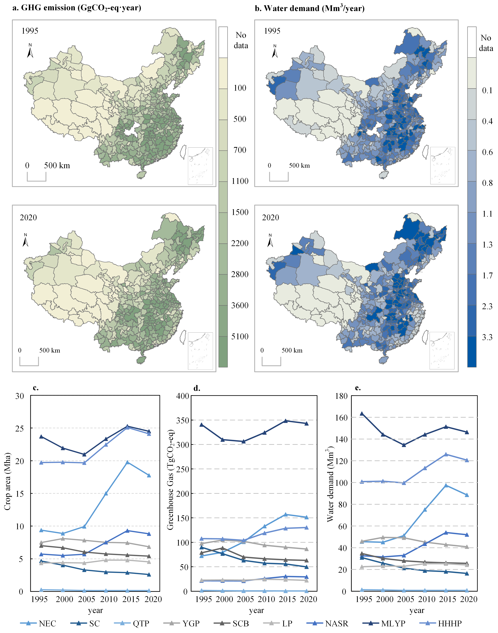
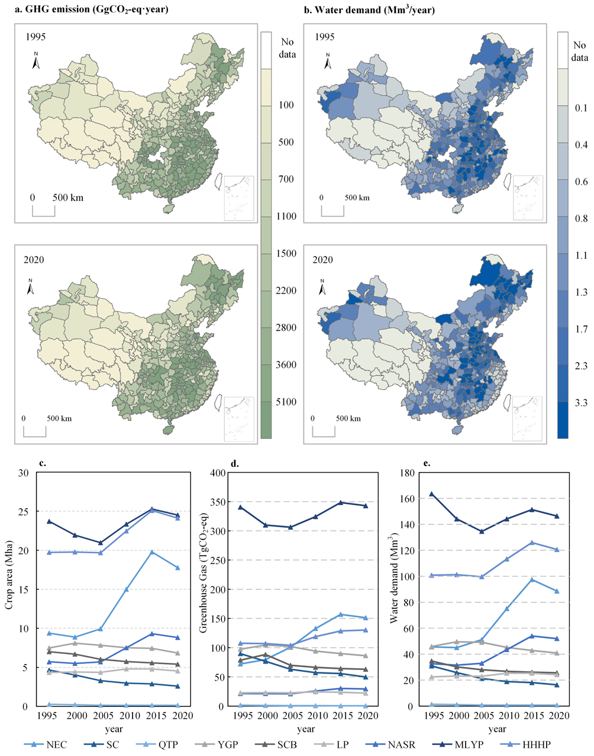
Research 2
MLYP
NEC
Fig. 6 Regional line graphs depicting changes in c. crop area, d. total GHG emissions, and e. crop water demand for each agricultural region in China over the study period.
Substantial disparities in both the total quantity and trends of GHG emissions across different regions are evident.
Along with the changes in grain scale, China's grain GHG emissions and water demand also went through a phase of increasing and then decreasing, reaching a peak in 2015.
Fig. 6 (a.) GHG emission and (b.) water demand of China's major grain from 1995 to 2020.
Notes:
In the case of a shift in cropping patterns, we simulated greenhouse gas emissions and water demand from 1995 to 2020. We only changed the cropping pattern.
I have shown the change characteristics of different regions on this page. The MLYP(middle and lower Yangtze River plain) region has been kept at the highest level compared to other regions, while the northeast of China has the largest amount of variation. We have displayed these details on Figure 6.

Slide 16
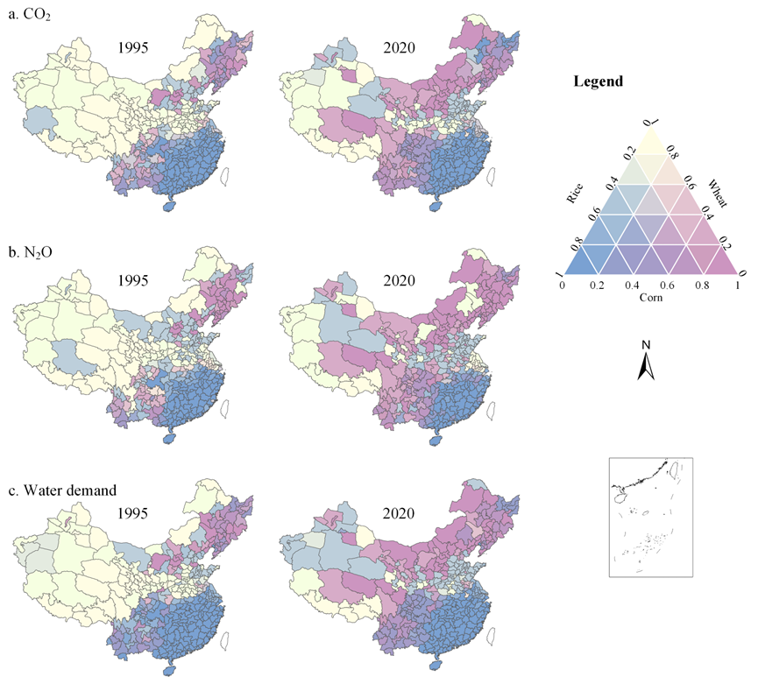
Research 2
regions previously dominated by wheat witnessed a shift towards areas predominantly cultivating rice and maize.
Different trends manifested in different regions.
The most significant changes were in the northern and south-western regions.
Fig. 7 Contribution of major grain to (a.) CO2 (b.) N2O emissions c. water demand in 1995 and 2020.
Notes:
To evaluate variations in GHG emissions from the three major grain across diverse regions, we conducted a detailed analysis of the contribution of CO2 and N2O emissions for each crop.
It considers the difference in cropping patterns and scale.
Similar to the Figure 5. Different colors represent the dominance of different crops. Such as The blue color indicates that the emissions or water demand in the region are mainly contributed by rice. Pink is corn, and yellow is wheat.
The region where wheat once contributed the most became rice and corn. This change matched the shifts in what crops are planted during the same time.

Slide 17
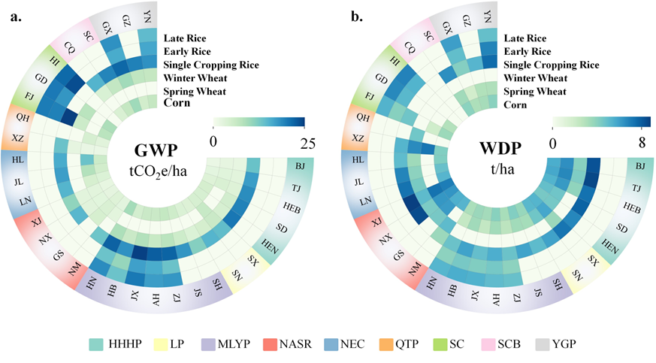
Research 2
Fig. 8 Heat Map of provincial GHG emissions (a.) and water demand (b.).
Notes:
We also draw a heat map to show the GHG emission and water demand for each province. Meanwhile we use the different color to divide provinces into different agricultural regions.

Slide 18
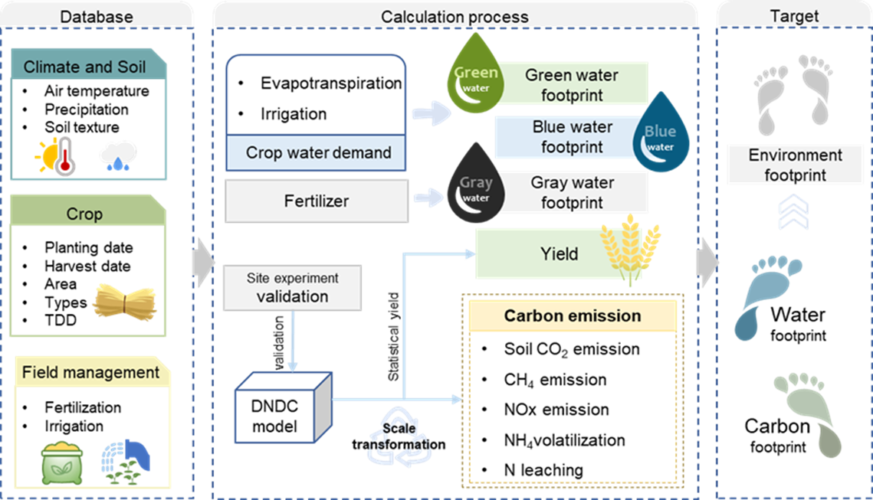
Research 3
Fig. 9 Framework for footprint evaluation model
Notes:
My final study delves into the evaluation of the environmental footprint of grain in China.
From previous studies, We realized that a single variable is insufficient to assess the sustainability of grain production due to its diverse spatial distribution.
In this research, we define the environmental footprint of farmland as the cumulative environmental pressure. This includes factors such as greenhouse gas emissions, use of freshwater, and nutrient pollution. The environmental footprint is further divided into water and carbon footprints, with the water footprint include green, blue, and gray water.
It's important to note that our study major focuses on assessing the environmental footprint at the production site. In the vast majority of cases, external activities such as processing and transportation of the product, extraction of fuel are excluded from our analysis.

Slide 19
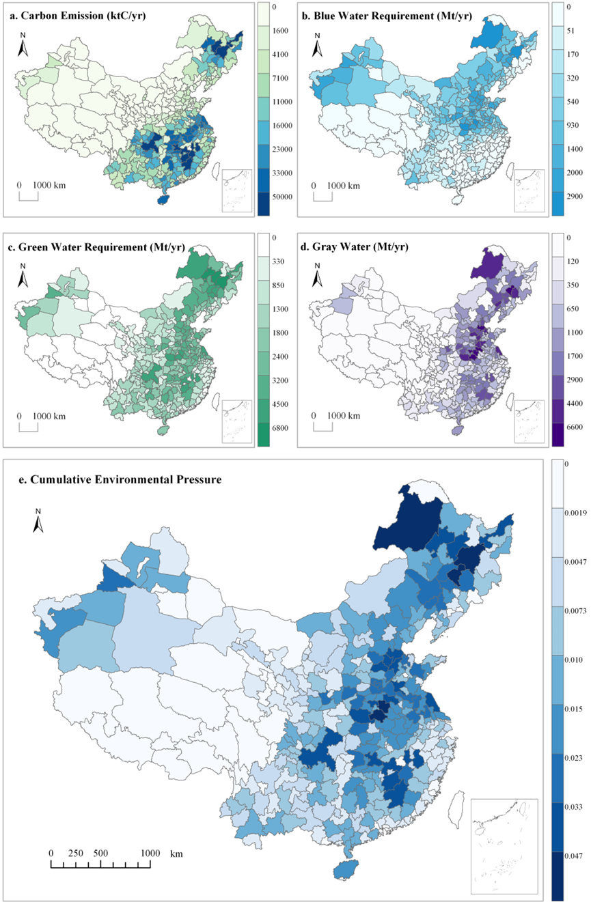

Research 3
Fig. 10 Spatial distribution of (a.) GHG emissions; (b.)Blue water requirement; (b.)Green water requirement; (b.)Gray water requirement;(e.) Cumulative environmental pressure
Notes:
Given that the spatial distributions of total city-level carbon emissions, blue water, green water, and gray water do not overlap and exhibit clustering in high-intensity areas, our study used a comprehensive approach. We utilize various environmental pressure to map the spatial distribution of cumulative environmental pressures at the city-level. taking into account various aspects such as carbon emissions and water usage.
Some of the results are shown on this page.

Slide 20
THANKS
Notes:
That’s all the presentation,
thanks for attention!

